Slide 1
Kubernetes Policies 101
Eran Leib Co-Founder, VP Product Management
July 2020

Slide 2
Agenda
Kubernetes, policies and configurations
Admission Controllers
Is It Enough?
From reactive to proactive

Slide 3
About Me
Eran Leib
Co-Founder, VP Product Management
Co-Founder & VP of Product Management at Apolicy and has more than 20 years of experience in security, identity, access and policies.
Prior to Apolicy, I co-founded Whitebox Security, a Data Access Governance platform that was acquired by SailPoint Technologies (NYSE: SAIL).
I enjoy hiking, movies, snowboarding, Lego (but not stepping on them!), cooking (without burning stuff) and traveling for fun.

Slide 4
“The future of app development has arrived, and cloud-native architecture has paved the way”
“The complexity of the cloud native Environment is all too likely to become all-out chaos.”
BUT

Slide 5
The Dynamic Nature Of Kubernetes
Kubernetes: Up and Running Brendan Burns, Joe Beda, Kelsey Hightower
“Kubernetes is a very dynamic system. The system is involved in placing pods on nodes, making sure they are up and running, and rescheduling them as needed. … The API-driven nature of the system encourages others to create higher levels of automation.”

Slide 6
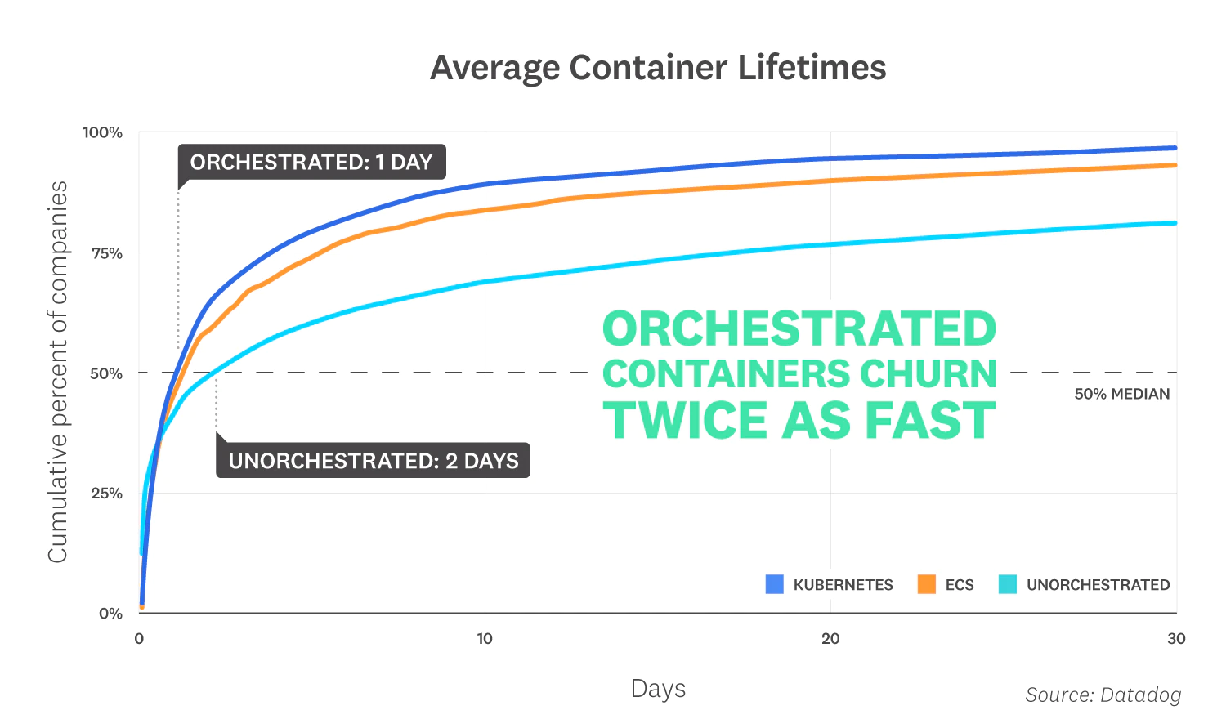
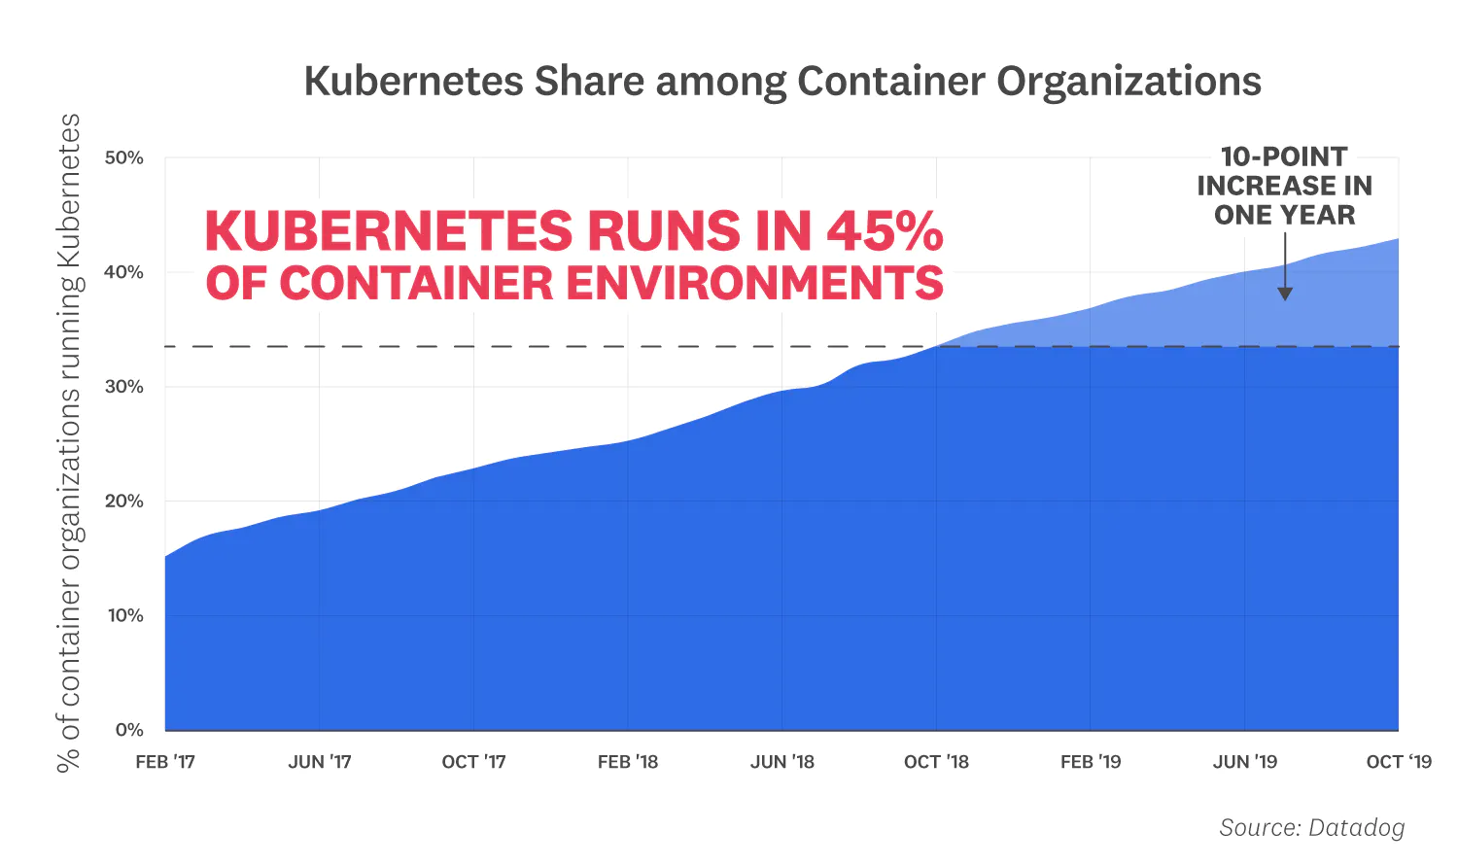
Ephemeral & Complex Is The New Norm
More clusters
More workloads per clusters
Extensive use of microservices
More multi-cloud environments

Slide 7
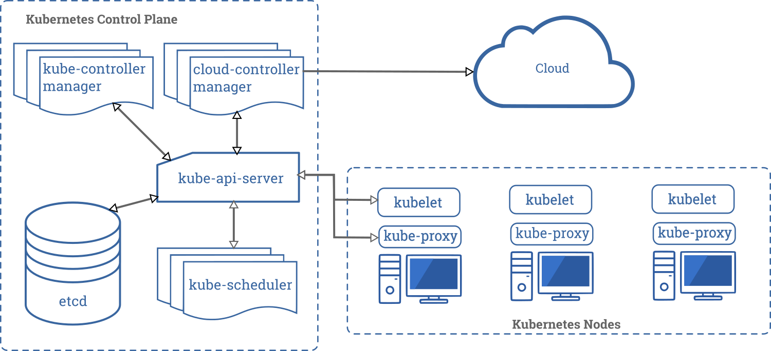
What Do We Want To Control?

Slide 8
Policies vs. Configurations
Configuration is a group of attributes defining behavior parameters, capabilities parameters & labels (of any kind) of an object
In kubernetes, configuration defines the desired state of the object and its behavior
Policy is a group of attributes defining allowed/denied of behavior/configuration for other objects
In kubernetes the policy mostly defines guardrails for the desired state

Slide 9
Declarative Infra. & Policy - Winning Duo
Kubernetes is a declarative infrastructure
The components’ configurations describe their desired state
Kubernetes is responsible to achieve the desired state
The “magic” is in the controller - Genie not included!
There are many controllers with at least one policy each

Slide 10
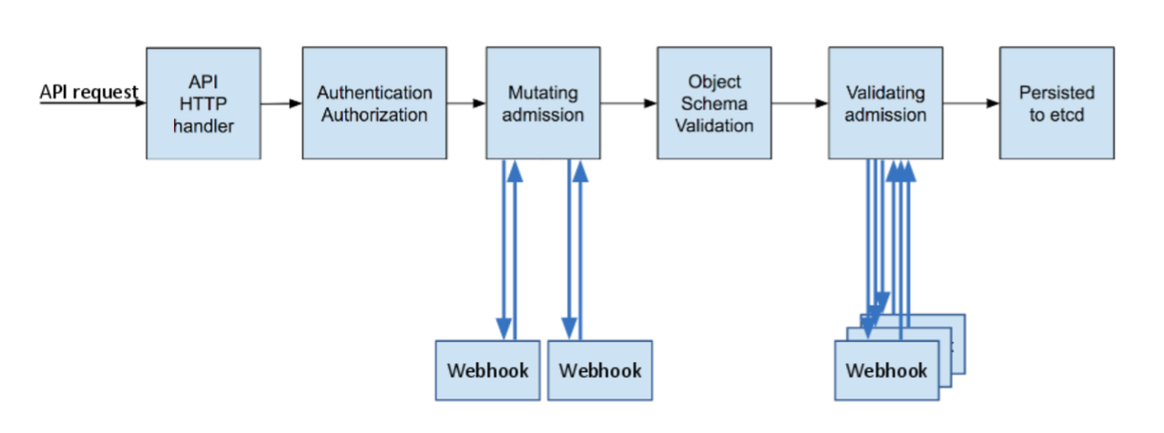
Our Focus today - Admission Controllers
Admission controllers validate creation and changes to Kubernetes objects before the API server persists them to etcd
The admission controllers enforce the configuration policies
They run serialy and pass/reject the entire request according to their defined policy
More specifically: Controllers with complex or coded policies

Slide 11
ImagePolicyWebhook
Images are the core of the workload
ImagePolicyWebhook check they comply with your policy
All requests goes through inspection and include all the workloads’ images and annotations
Default deny is more secure, however, if no one is there to take the call your cluster would be down and nothing would be admitted!
Default allow is the easy way out - not the right way

Slide 12
Sample Request & Response
{
"apiVersion":"imagepolicy.k8s.io/v1alpha1",
"kind":"ImageReview",
"spec":{
"containers":[
{
"image":"myrepo/myimage:v1"
},
{
"image":"myrepo/myimage@sha256:beb6bd6a68f114c1dc2ea4b28db81bdf91de202a9014972bec5e4d9171d90ed"
}
],
"annotations":{
"mycluster.image-policy.k8s.io/ticket-1234": "break-glass"
},
"namespace":"mynamespace"
}
}
?
{
"apiVersion": "imagepolicy.k8s.io/v1alpha1",
"kind": "ImageReview",
"status": {
"allowed": false,
"reason": "image currently blacklisted"
}
}

Slide 13
Image Policy - Shortcomings
No OOTB simple policy to overcome the simple use cases
Operations vs Security instead of Secured Operations
Default allow vs default deny
Doesn’t have full context of the workload - only the annotations
Cannot filter which requests come in (e.g. kube-system)

Slide 14
Resources - Quotas & Limits
Kubernetes provides two ways of policing the resources distribution
The ResourceQuota object defines the quota per namespace
The LimitRanger object defines the limits per workload inside the namespace
ResourceQuota defined by Cluster Admin and LimitRanger by the namespace admin
Any running workload will not be affected until recreated

Slide 15
ResourceQuota
ResourceQuota is an admission controller enforcing the policy
To enforce it, you must create a ResourceQuota object in each namespace
With no object defined, the namespace can use resources without limits
Using a quota should be in tandem with LimitRanger to make sure default values are assigned on resources
Your Pod can be rejected if resources are not defined and LimitRanger is not used

Slide 16
LimitRanger
LimitRanger defines ranges for CPU/RAM/Storage for a Pod/Container inside the namespace
The admission controller defines, MIN/MAX, ratio between request/limit and default values
A LimitRanger object must be defined to enforce the limits
Without a limit, any workload can create starvation for the others
If the LimitRanger allows more resources than the ResourceQuota you will run into contention and Pod creation failures

Slide 17
Pod Security Policy (PSP)
PSP defines the security guardrails for workloads in the cluster
PSP works with policy profiles
The workload service account must be able to ‘use’ the PSP to enforce it
Each profile is a complete set of the parameters
A workload will “choose” the easiest path in that will allow it in as-is
Hint: Recently a list of 3 standard profiles was published
https://kubernetes.io/docs/concepts/security/pod-security-standards/
“The three profiles defined here have a clear linear progression from most secure (restricted) to least secure (privileged), and cover a broad set of workloads. Privileges required above the baseline policy are typically very application specific, so we do not offer a standard profile in this niche. This is not to say that the privileged profile should always be used in this case, but that policies in this space need to be defined on a case-by-case basis.”

Slide 18
PSP - What’s Covered
Workload <> Host isolation parameters (Network, process, FS)
Container Security Context (user, group, capabilities)
Volumes (allowed types, root FS, etc)
Privilege Escalations (privileged, allow escalation)
A total of 20+ parameters

Slide 19
Privileged
apiVersion: policy/v1beta1
kind: PodSecurityPolicy
metadata:
name: privileged
annotations:
seccomp.security.alpha.kubernetes.io/allowedProfileNames: '*'
spec:
privileged: true
allowPrivilegeEscalation: true
allowedCapabilities:
- '*'
volumes:
- '*'
hostNetwork: true
hostPorts:
- min: 0
max: 65535
hostIPC: true
hostPID: true
runAsUser:
rule: 'RunAsAny'
seLinux:
rule: 'RunAsAny'
supplementalGroups:
rule: 'RunAsAny'
fsGroup:
rule: 'RunAsAny'

Slide 20
Restricted
apiVersion: policy/v1beta1
kind: PodSecurityPolicy
metadata:
name: restricted
...
spec:
privileged: false
# Required to prevent escalations to root.
allowPrivilegeEscalation: false
# This is redundant with non-root + disallow privilege escalation,
# but we can provide it for defense in depth.
requiredDropCapabilities:
- ALL
# Allow core volume types.
volumes:
- 'configMap'
- 'emptyDir'
- 'projected'
- 'secret'
- 'downwardAPI'
# Assume that persistentVolumes set up by the cluster admin are safe to use.
- 'persistentVolumeClaim'
hostNetwork: false
hostIPC: false
hostPID: false
runAsUser:
# Require the container to run without root privileges.
rule: 'MustRunAsNonRoot'
...

Slide 21
Hard To Manage & Harder To Enforce
Every permutation/exception you want make = new PSP … and a new role … and a new role binding Managing access to the psp is managing how it’s applied
An admitted workload shows which PSP admitted it … a failed one, go figure :(
Unlike other controllers, it is not managing a specific aspect but a broad set of capabilities

Slide 22
Labels, Labels, Labels
Labeling is a cornerstone in Kubernetes
Label selector - Is the primitive for grouping objects
Some of the places where label selectors are used in:
Scheduling workloads to nodes - e.g. schedule PCI workloads on PCI approved nodes using PCI label
Selecting services for workload - exposing the web component only through a service
Any kubectl command can use label selectors
It is also used to “document” the objects (app, owner etc.)
Hint: Annotations are a better way for documenting

Slide 23
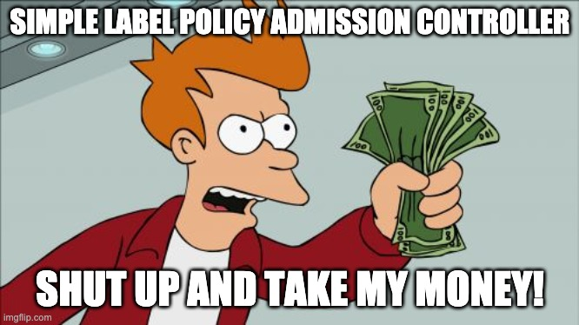

Slide 24
Mutating Admission Controllers
The first type of admission controllers to evaluate
Multiple admission controllers can exist.
They run serially, mutate the request and pass it forward
Only requests which meet the specific controller are evaluated
This should be used with caution as it changes the original request
Receives the whole request with all fields as input
Recommended to use for setting unset values rather than changing existing ones
Hint: Use these to automatically add missing labels

Slide 25
Validating Admission Controllers
The last type admission controller to evaluate
They run in parallel and each can fail the whole request
Only requests which meet the specific controller are evaluated
Receives the whole request with all fields as input
The good: Anything is possible…
The bad: Anything is possible!

Slide 26
Sample Request & Response
{
"apiVersion": "admission.k8s.io/v1",
"kind": "AdmissionReview",
"request": {
"uid": "705ab4f5-6393-11e8-b7cc-42010a800002",
"kind": {"group":"autoscaling","version":"v1","kind":"Scale"},
"resource": {"group":"apps","version":"v1","resource":"deployments"},
"subResource": "scale",
"requestKind": {"group":"autoscaling","version":"v1","kind":"Scale"},
"requestResource": {"group":"apps","version":"v1","resource":"deployments"},
"requestSubResource": "scale",
"name": "my-deployment",
"namespace": "my-namespace",
"operation": "UPDATE",
"userInfo": {
"username": "admin",
"uid": "014fbff9a07c",
"groups": ["system:authenticated","my-admin-group"],
"extra": {
"some-key":["some-value1", "some-value2"]
}
},
"object": {"apiVersion":"autoscaling/v1","kind":"Scale",...},
"oldObject": {"apiVersion":"autoscaling/v1","kind":"Scale",...},
"options": {"apiVersion":"meta.k8s.io/v1","kind":"UpdateOptions",...},
"dryRun": false
}
}
{
"apiVersion": "admission.k8s.io/v1",
"kind": "AdmissionReview",
"response": {
"uid": "<value from request.uid>",
"allowed": false,
"status": {
"code": 403,
"message": "You cannot do this because..."
}
}
}
?

Slide 27
Pinpoint Admission Controllers
Some admission controllers are controlling a single focused aspect of the process, hence their policy is very simple and it is enforced cluster-wide
To name a few (some are alpha/beta):
AlwaysPullImages
DefaultStorageClass
EventRateLimit
PodNodeSelector

Slide 28
Recap
Admission controllers are a great mechanism to enforce policies
Their policies are managed in many places making it complex to understand the actual effective policy
Moving to multi cloud and multi cluster complicates things even more

Slide 29
4 Things To Do Today
Check which admission controllers are enabled
kubectl get pods -n kube-system | grep apiserver
kubectl describe pods <apiserver pod> -n kube-system | grep admission
The above is for vanilla kubernetes.
For each cloud provider check the specific documentation
Start namespacing, it will make your policy management better and easier
Stop using “default” service account name - use named accounts
Enable basic PodSecurityPolicy using the restricted, baseline, privileged example
https://kubernetes.io/docs/concepts/policy/pod-security-policy/

Slide 30
POLICIES IN ACTION DEMO

Slide 31
So What’s The Problem?
There is a clear need to decouple policy from the controllers’ code
Kubernetes dynamic nature teaches us that policies evolve and will continue to evolve over time
Multi cluster & cloud expansion will push the need for a centrally managed and orchestrated policies even further
Too many enforcement points and overlaps between controllers can end up in an all out chaos
It is highly recommended to manage and enforce the same policies from dev and all the way to production

Slide 32
Policy-As-Code
A good first step in the right direction!
Policy-as-code allows to decuple policy from code
Enables declarative policy
Some solutions works with Kubernetes natively
OPA Gatekeeper - a great example and a good place to start

Slide 33
Consistent Actions > Consistent Results
Admission controllers are not enough
They are the last gate keepers before the cluster
It is important to have them but it’s more important to identify issues way ahead
The same policy guiding admission controller must be enforced in earlier stages (Git & CD processes)

Slide 34
Risk To Policy To Remediation -
Identify Risk
1
Policy
Orchestration
Remediate Violations
3
2
Build Policy

Slide 35
Kubernetes Policy, Risk Maturity Model
Orchestrated and Automated
Remediation
Periodic
Remediation
Remediation
After the fact
Sporadic
Remediation
Proactive recommendations
Policy
DIY Guardrails
Policy
Standard Template
Guardrails
Policy
Default /
No Policy
Policy
Workload specific Risk Information, based on usage and deep analysis
CIS and Compliance
Risk
“CIS fits all”
Risk
No Risk
Assessment
Risk
Risk
Unaware
Opportunistic
Advanced
Transformational

Slide 36
It’s time for Better Kubernetes
Be Risk Smart
Assess workload exposure and prioritize risks for action
Be Declarative
Achieve the workload state you’ve declared
Be Right
Prevent issues before they arise

